Slide 1
Chapter 1 Tables

Slide 2
Why Organize Data in Tables?
The need to organize information existed long before computers and databases. Early civilizations kept records of important information such as?
taxes, property, trade, crops, livestock, and population.
Ancient record keepers used clay tablets, papyrus, and later paper ledgers to maintain these records.
Information could be written in a free-form style, such as?
Marcus paid 20 coins in taxes and owns 3 acres. Julia owns 5 acres of land and paid 25 coins. Antonius paid 15 coins in taxes and owns only 2 acres.
While this free-form approach may be understandable for a small amount of information, it becomes increasingly difficult to manage as hundreds or thousands of records accumulate. Finding a particular person, comparing values, calculating totals, or identifying missing information could require searching through large amounts of text. What do you think people could have done to organize this information more effectively?
Earlier civilizations recognized that a table provides a much more organized approach:
Person | Tax Paid | Land Owned
Marcus | 20 coins | 3 acres
Julia | 25 coins | 5 acres
Antonius | 15 coins | 2 acres

Slide 3
File-Based Systems and Tables
Tables organize information into rows and columns. Each row can represent one person, item, or transaction, while each column represents the same type of information for every record.
What are some advantages of using a table?
Tables data easier to read, compare, sort, search, count, and summarize.

Slide 4
What is a table?
A table is a structured collection of related data organized into rows and columns. Each table represents a single entity (such as Customer information, Students, Employees, etc), where each row represents one record and each column represents a specific attribute or field of that record.
Tables provide an organized way to store, retrieve, update, and manage data efficiently while maintaining relationships with other tables through keys.

Slide 5
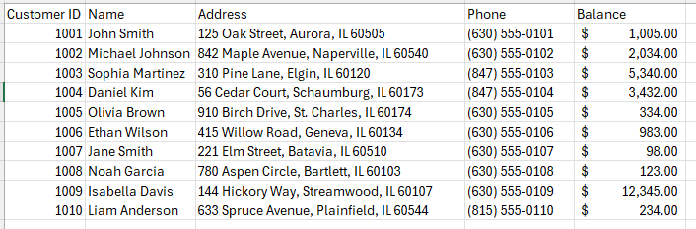
Imagine the savings account for customers. What data do you think are relevant to store for each customer?
Table
Why is it a good idea to have
a Custermer ID field?
Attribute or Field
Record

Slide 6
Tools for Creating and Managing Table-Based Data
Data can be stored in several file formats that organize information into rows and columns. These files can be created and edited using different software tools.
Can you think of different apps we use to create a table?
Microsoft Excel is one of the most commonly used tools for creating tables. It primarily uses the .xlsx format, while older versions of Excel used .xls. Excel supports formulas, formatting, charts, multiple worksheets, and other features for organizing and analyzing data. A .csv file stores data as plain text, with values usually separated by commas.
Google Sheets is a web-based spreadsheet application. Like Excel, it allows users to create and manipulate data in rows and columns. Google Sheets files can be downloaded or exported as .xlsx, .csv, and several other formats.
LibreOffice Calc is a free and open-source spreadsheet application. Its standard spreadsheet format is .ods, but it can also open and save files in formats such as .xlsx, .xls, and .csv. It provides many of the same basic spreadsheet features as Microsoft Excel.

Slide 7
Possible problems with using tables
Although file-based tables are relatively simple to create and use, problems can arise as the amount of data grows and multiple files need to share related information.
These problems can include:
data redundancy, data inconsistency, data isolation, and difficulty maintaining relationships between data.

Slide 8
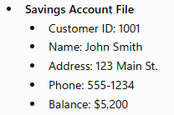
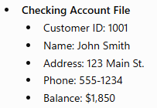
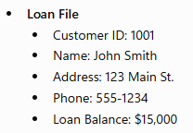
Data Redundancy
Imagine the savings, checking and loan account for customers.
Why is this a potential source of a problem?
Information is duplicated across multiple files.
If John Smith moves to a new address, the bank must update every file containing his address. If one file is updated but another is not, the bank ends up with conflicting information.
Data redundancy is a situation that occurs in a database when a field needs to be updated in more than one table.

Slide 9
Data Inconsistency
Suppose a customer, John Smith, changes his address from 123 Main St. to 456 Oak Ave. Because the bank uses a file-based system, his information is stored separately in the:
Savings Account File → Address updated to 456 Oak Ave. ✅
Checking Account File → Still 123 Main St. ❌
Loan File → Address updated to 456 Oak Ave. ✅
Now the bank has conflicting information about the same customer. One department may send statements to the old address while another sends them to the new address.
This is an integrity problem because the data is no longer accurate and consistent across the system.
A Data Inconsistency occurs when the accuracy or consistency of data is compromised, resulting in conflicting or incorrect information.

Slide 10
Data Redundancy is not automatically bad.
But unnecessary or uncontrolled data redundancy is a problem.
For example, suppose the department name Information Technology is repeated for 500 employees in a single Employee table:
That redundancy creates several potential problems:
Wasted storage — the same information is stored repeatedly. This is less important today for small data, but can matter at scale.
Update problems — if the department changes its name to Technology Services, you may need to update hundreds of records.
Inconsistency risk — some records might be updated while others are not.
Maintenance overhead — the same fact has to be maintained in multiple places.
EmployeeID | Name | Department
1001 | Emily | Information Technology
1002 | Michael | Information Technology
1003 | Sophia | Information Technology
... | ... | ...

Slide 11
A database design would typically separate this into:
EMPLOYEE
DEPARTMENT
Now the fact that Department 2 is called Information Technology is stored once.
EmployeeID | Name | DepartmentID
1001 | Emily | 2
1002 | Michael | 2
1003 | Sophia | 2
DepartmentID | DepartmentName
2 | Information Technology

Slide 12
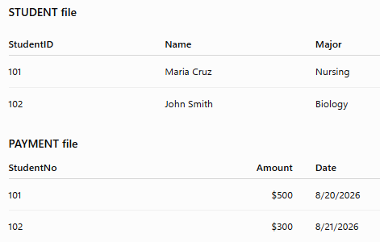
Data Isolation
Suppose a school uses separate files:

Slide 13
Why is this a problem?
If a new application needs to display each student's name together with their payments, it must know:
which files contain the required information,
how each file is structured,
that StudentID in one file corresponds to StudentNo in another, and
how to combine the records correctly.
In a traditional file-based system, these relationships are often handled by application programs rather than centrally by a DBMS. As the number of files and applications increases, retrieving and combining related data becomes increasingly difficult.
Data isolation occurs when the data exists, but because it is scattered and isolated in different files, a new program may have difficulty finding and combining the data it needs.

Slide 14
Another problem with Data Isolation
Suppose two separate files/tables store the same date differently:
Customers.csv → 08/29/2026
Orders.csv → 2026-08-29
Another system → 29-Aug-2026
The data isolation problem is that related data is stored in different files, formats, or systems, making it harder for an application to retrieve, combine, and process the data.

Slide 15
Data Security
Suppose a bank teller's job is to process deposits and withdrawals for checking and savings accounts only. However, because the file-based system has poor access controls, the teller can also open the Loan File.
As a result, the teller can view confidential information such as:
Customers' loan balances
Credit history
Monthly loan payments
Why is this a problem?
Even though this information is unrelated to the teller's job, they still have access to it.
A security problem occurs when unauthorized users are able to access, view, modify, or delete data they should not have permission to access.

Slide 16
Data Concurrency
Suppose John Smith has $5,000 in his checking account.
At the same time:
A bank teller is processing a $1,000 cash withdrawal.
An ATM is processing a $500 withdrawal from the same checking account.
Both transactions read the balance before either one updates it.
The teller reads the balance: $5,000.
The ATM also reads the balance: $5,000.
The teller subtracts $1,000 and saves the new balance: $4,000.
The ATM subtracts $500 from the balance it originally read ($5,000) and saves $4,500.
The final balance becomes $4,500, when it should be $3,500.
This happened because both transactions accessed and updated the same account simultaneously, causing one update to overwrite the other.
A concurrency problem occurs when two or more users or transactions access and modify the same data at the same time, resulting in incorrect or inconsistent data.

Slide 17
So, to summarize, the issues with maintaining a file-based system are:
Data Redundancy- is a situation that occurs in a database when a field needs to be updated in more than one table.
Data Inconsistency- occurs when the accuracy or consistency of data is compromised, resulting in conflicting or incorrect information.
Data Isolation - occurs when related data is stored in separate files or systems, making it difficult to access, combine, and analyze the information.
Security problem - occurs when unauthorized users are able to access, view, modify, or delete data they should not have permission to access.
Concurrency problem - occurs when two or more users or transactions access and modify the same data at the same time, resulting in incorrect or inconsistent data.

Slide 18
